Slide 1
MQTT Contribution

Slide 2
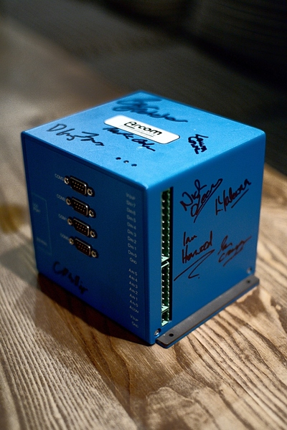
What is being contributed
MQTT was co-invented by IBM and Arcom Systems over 13 years ago.
The current MQTT specification is available here:
  http://www.ibm.com/developerworks/webserices/library/ws-mqtt/index.html
  This specification is being contributed to OASIS.
It is available under an open and royalty free license.
Abstract from the MQTT spec web site: The MQ Telemetry Transport (MQTT) protocol is a lightweight publish/subscribe protocol flowing over TCP/IP for remote sensors and control devices through low bandwidth, unreliable or intermittent communications. This protocol specification has not been standardized. It is made available here under a royalty free license

Slide 3
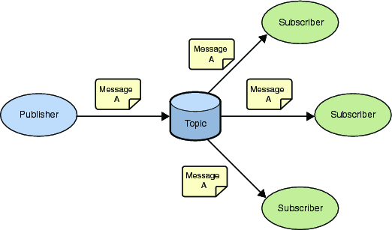
MQTT - Publish Subscribe Messaging aka One to Many
A Publish Subscribe messaging protocol allowing a message to be published once and multiple consumers (applications / devices) to receive the message providing decoupling between the producer and consumer(s)
A producer sends (publishes) a message (publication) on a topic (subject)
A consumer subscribes (makes a subscription) for messages on a topic (subject)
A message server / broker matches publications to subscriptions
If no matches the message is discarded
If one or more matches the message is delivered to each matching subscriber/consumer

Slide 4
MQTT - Publish Subscribe Messaging aka One to Many
A topic forms the namespace
  Is hierarchical with each “sub topic” separated by a /
  An example topic space
    A house publishes information about itself on:
      <country>/<region>/<town>/<postcode>/<house>/energyConsumption
      <country>/<region>/<town>/<postcode>/<house>/solarEnergy
      <country>/<region>/<town>/<postcode>/<house>/alarmState
      <country>/<region>/<town>/<postcode>/<house>/alarmState
    And subscribes for control commands:
      <country>/<region>/<town>/<postcode>/<house>/thermostat/setTemp
A subscriber can subscribe to an absolute topic or can use wildcards:
  Single-level wildcards “+” can appear anywhere in the topic string
  Multi-level wildcards “#” must appear at the end of the string
  Wildcards must be next to a separator
  Cannot be used wildcards when publishing
  For example
    UK/Hants/Hursley/SO212JN/1/energyConsumption
      Energy consumption for 1 house in Hursley
    UK/Hants/Hursley/+/+/energyConsumption
      Energy consumption for all houses in Hursley
    UK/Hants/Hursley/SO212JN/#
      Details of energy consumption, solar and alarm for all houses in SO212JN
A Publish Subscribe messaging protocol allowing a message to be published once and multiple consumers (applications / devices) to receive the message
  Support loose coupling
  Durable and non durable subscriptions
  A publication may be retained
    Wildcards must be next to a separator
    Can't use wildcards when publishing

Slide 5
MQTT - Publish Subscribe Messaging aka One to Many
A subscription can be durable or non durable
  Durable:
    Once a subscription is in place a broker will forward matching messages to the subscriber:
      Immediately if the subscriber is connected
      If the subscriber is not connected messages are stored on the server/broker until the next time the subscriber connects
  Non-durable: The subscription lifetime is the same as the time the subscriber is connected to the server / broker
A publication may be retained
  A publisher can mark a publication as retained
  The broker / server remembers the last known good message of a retained topic
  The broker / server gives the last known good message to new subscribers
    i.e. the new subscriber does not have to wait for a publisher to publish a message in order to receive its first message

Slide 6
Use on Constrained Networks
Designed for constrained networks:
  Protocol compressed into bit-wise headers and variable length fields.
  Smallest possible packet size is 2 bytes
  Asynchronous bidirectional “push” delivery of messages to applications (no polling)
    Client to server and server to client
  Supports always-connected and sometimes-connected models
  Provides Session awareness
    Configurable keep alive providing granular session awareness
    “Last will and testament” enable applications to know when a client goes offline abnormally
  Typically utilises TCP based networks e.g. Webscokets
  Tested on many networks – vsat, gprs, 2G….
Provides multiple deterministic message delivery qualities of service
  0 – message delivered at most once.
  1 – message will be delivered but may be duplicated
  2 – once and once only delivery
  QOS maintained over fragile network even if connection breaks

Slide 7
Constrained Device
Designed for constrained devices:
  Suited to applications / devices that may have limited resources available
    8 Bit controllers upwards
    Battery
  Multiple MQTT client implementations available in many form factors / languages
    Tiny footprint MQTT client (and server) libraries e.g. a c client lib in 30Kb and a Java lib in 64Kb

